Slide 1
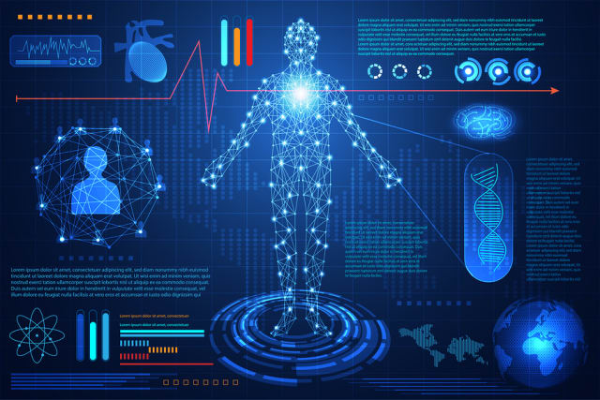
Detection Of Disease via
Blood Analysis Using
Machine Learning

Slide 2

Detection Of Diseases via Blood Analysis Using Machine Learning
University of Rajshahi
Presented by
Supervised by
Devit Chandra Roy (1710776108)
Mayisa Sanchita (1612076130)
Md. Julfiker Ali (1710476105)
Dr. Bimal Kumar Pramanik
Professor
Computer Science and Engineering
University Of Rajshahi

Slide 3
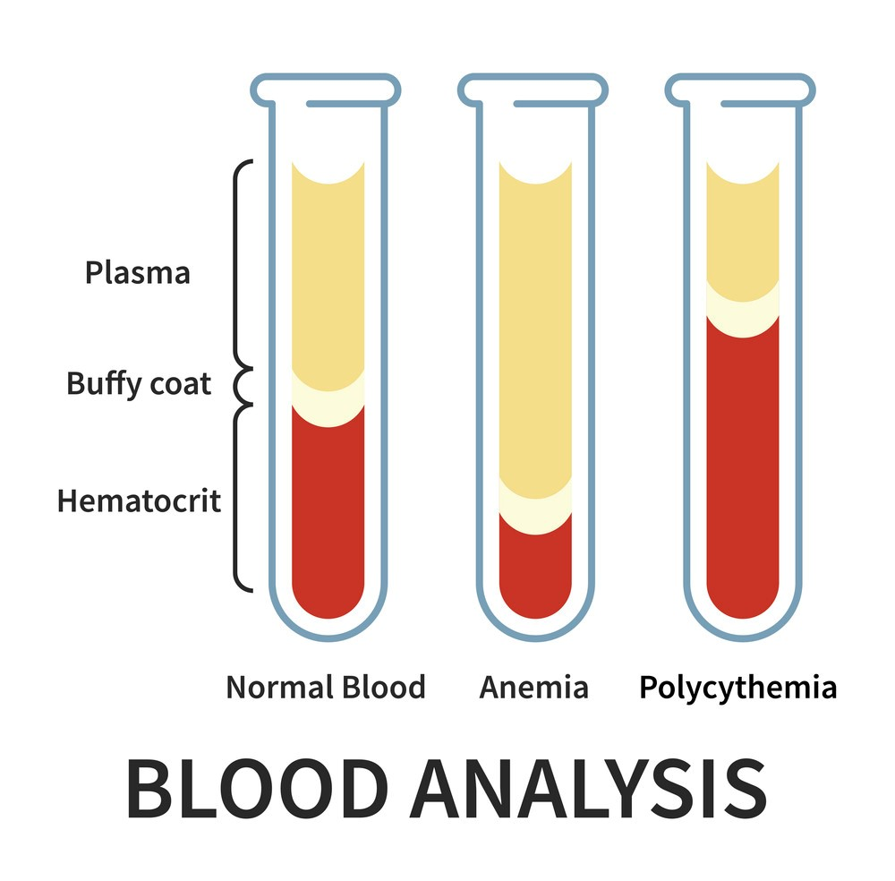
Introduction
Blood has many secrets that affect human life.
It is the postman that circulates through body and visits all organs
The growth in WBC,RBC,PLT should be reflected in blood. This change could be detected by the values of parameters inside blood analysis tests . Depending on several attributes like age, gender, symptoms, and any health conditions, the physician can choose the specific blood tests for diagnosing the disease. Many blood tests are standard and essential for everyone to get. Blood tests are widespread because of that; most physicians may recommend blood tests to predict the health level of the patient’s body

Slide 4
Objectives
Quick diagnosis of diseases
Separate the affected and non-affected RBCs
Improve speed and accuracy in the results

Slide 5
Why this system is better than existing one?
No extra IoT device needed
No cloud system is needed
Accuracy is higher than the others
Deals with an wider range of diseases
provides possibility of occurrence of any diseases

Slide 6
Methodology
Working Flow:
Collection of Dataset
Selection of attributes
Data Pre-Processing
Splitting of Data
Model Generation
Evaluation

Slide 7
KNN Classifier Algorithm:
K-nearest neighbors (KNN) algorithm is a type of supervised ML algorithm which can be used for both classification as well as regression predictive problems. However, it is mainly used for classification predictive problems in industry.

Slide 8
How does KNN work:
Step 1 − Load datasets
Step 2 − Next, choose K-value.
Step 3 − Test data−
3.1 − Calculate the distance between test data and each row of training data with the help of any of the method namely: Euclidean, Manhattan or Hamming distance. The most commonly used method to calculate distance is Euclidean.
3.2 − Now, based on the distance value, sort them in ascending order.
3.3 − Next, it will choose the top K rows from the sorted array.
3.4 − Now, it will assign a class to the test point based on most frequent class of these rows.
Step 4 − End

Slide 9
Implementation:
Steps to implement the K-NN algorithm:
Data Pre-processing step
Fitting the K-NN algorithm to the Training set
Predicting the test result
Test accuracy of the result(Creation of Confusion matrix)
Visualizing the test set result.

Slide 10
Decision Tree Algorithm
Decision Trees are simple and interpretable models that recursively split the data based on features to form a tree-like structure. They are useful for visualizing the decision-making process.

Slide 11
Decision Tree Algorithm…..
● Step-1: Begin the tree with the root node, says S, which contains the complete dataset.
● Step-2: Find the best attribute in the dataset using Attribute Selection Measure (ASM).
● Step-3: Divide the S into subsets that contains possible values for the best attributes.
● Step-4: Generate the Decision Tree node, which contains the best attribute.
● Step-5: Recursively make new decision trees using the subsets of the dataset created in step -3. Continue this process until a stage is reached where you cannot further classify the nodes and call the final node as a leaf node.

Slide 12
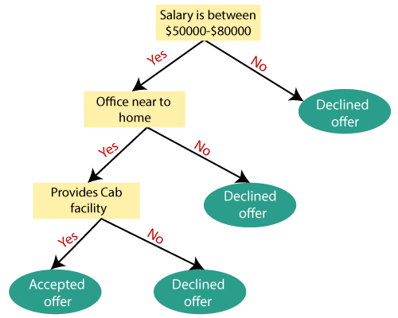
Decision Tree Algorithm….

Slide 13
Random Forest Algorithm
Random Forest algorithm is a method that operates by constructing decision trees during training. The decision of the majority of the trees is chosen by the random forest as the final decision.
By combining predictions from multiple decision trees, overfitting to the training data is mitigated.

Slide 14
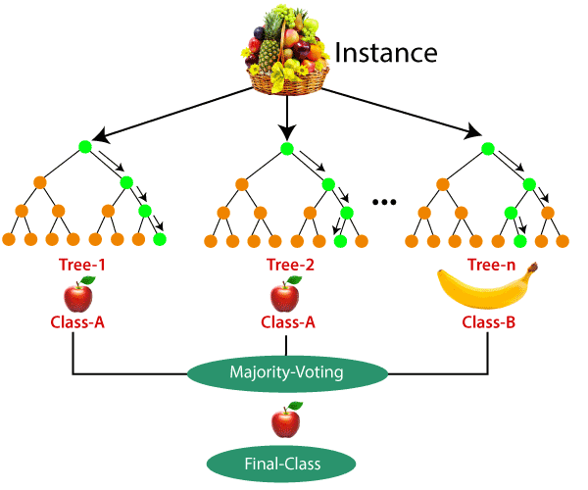
Example of RF tree

Slide 15
Random Forest Algorithm ..…
Step-1: Select random K data points from the training set.
Step-2: Build the decision trees associated with the selected data points (Subsets).
Step-3: Choose the number N for decision trees that we want to build.
Step-4: Repeat Step 1 & 2 as long as N number of decision trees will be generated.
Step-5: For new data points, find the predictions of each decision tree, and assign the new data points to the category that wins the majority votes.

Slide 16
Limitations
Knowledge of Internet and smart device needed.
Data may vary for people of different ages
Blood sample may vary from person to person
The process of payment method is not defined.
Suffer from regional focus, limited functionalities, and lack of scalability.
16

Slide 17
Conclusion:
Finally, an online application might be established. A people from anywhere the world can get the service. A shortest time would be necessary to detect various diseases. It can be used easily by the user and they get early awaked and go to the specialized. For this reason, it may prevent to create a acute disease for taking action early.

Slide 18


